Slide 1
Distributed Masters and Slaves Architecture with CJOC

Slide 2
What is a distributed architecture?
In OSS Jenkins, a distributed architecture is one where masters can distribute a workload between nodes called build agents or slaves.
With CloudBees, another architecture is also possible, where slaves and even masters can be dynamically brought online to build and schedule workloads respectively.

Slide 3
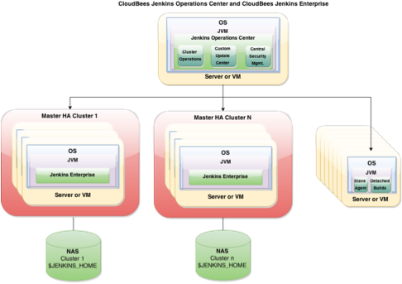
What is a distributed architecture?

Slide 4
Benefits: efficient resource usage
Jenkins masters and their slaves can be dynamically provisioned, allowing offline resources to be utilized elsewhere.
Jenkins masters will be able to orchestrate more builds.
Slaves and masters can be created from a template, standardizing them and reducing master onboarding time to 0.

Slide 5
Where do we start?
Install Operations Center, then configure client masters and shared slaves
See other sections for details on this

